Slide 1
Regression

Slide 2
Slope
Recap of basic concepts
Slope of a linear regression line tells us - how much change in y-variable is caused by a unit change in x-variable.
The slope indicates the steepness of a line and the intercept indicates the location where it intersects an axis. The slope and the intercept define the linear relationship between two variables, and can be used to estimate an average rate of change.
The greater the magnitude of the slope, the steeper the line and the greater the rate of change.

Slide 3
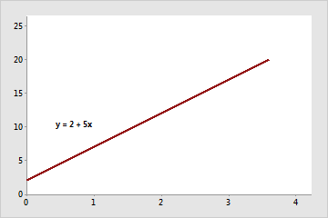

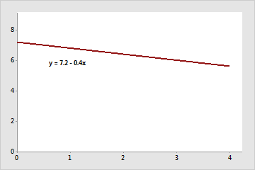

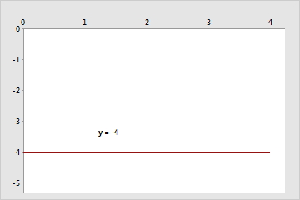

The slope is positive 5. When x increases by 1, y increases by 5. The y-intercept is 2.
The slope is negative 0.4. When x increases by 1, y decreases by 0.4. The y-intercept is 7.2.
The slope is 0. When x increases by 1, y neither increases or decreases. The y-intercept is -4.

Slide 4
Intercept
The slope indicates the steepness of a line and the intercept indicates the location where it intersects an axis. The slope and the intercept define the linear relationship between two variables, and can be used to estimate an average rate of change.
The intercept (often labeled as constant) is the point where the function crosses the y-axis.

Slide 5
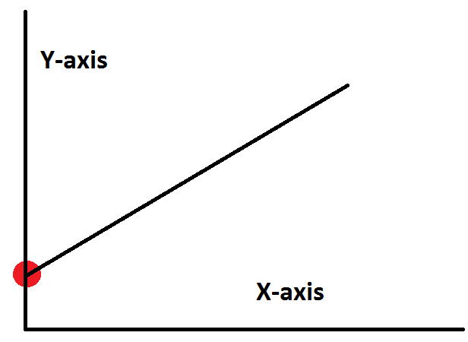
y-intercept
A positive y-intercept means the line crosses the y-axis above the origin, while a negative y-intercept means that the line crosses below the origin. Simply by changing the values of m and b, we can define any straight line. That's how powerful and versatile the slope intercept formula is.

Slide 6
Slope and intercept example
For example, a company determines that job performance for employees in a production department can be predicted using the regression model y = 130 + 4.3x, where x is the hours of in-house training they receive (from 0 to 20) and y is their score on a job skills test.
The value of the y-intercept (130) indicates the average job skill score for an employee with no training.
The value of the slope (4.3) indicates that for each hour of training, the job skill score increases, on average, by 4.3 points.

Slide 7
Marginal change / Slope
Marginal change – in working with two variables related by a regression equation, the marginal change in a variable is the amount that the variable changes when the other variable changes by exactly one unit
  The slope, 𝑏₁, in the regression equation is the marginal change in 𝑦 when 𝑥 changes by one unit

Slide 8
Types of regression models
Simple linear regression
Multiple regression
Logistic regression
Polynomial regression

Slide 9
Simple linear regression
We find the equation of the straight line that best fits the paired sample data. That equation algebraically describes the relationship between two variables.
The best-fitting straight line is called a regression line and its equation is called the regression equation.

Slide 10
Simple linear regression
Regression Equation – given a collection of paired sample data, the regression equation that algebraically describes the relationship between the two variables 𝑥 and 𝑦 is 𝑦 =𝑏₀+𝑏₁𝑥
  The regression equation attempts to describe a relationship between two variables
  Inherently, the equation algebraically describes how the values of one variable are somehow associated with the values of the other variable
Regression line – the graph of the regression equation
  Also known as the “line of best fit” or the “least square line”
  The regression line fits the sample points best

Slide 11
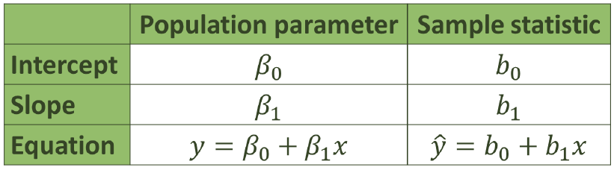
notation
Notice the 𝑦 in the sample regression equation!
This implies that we are predicting something!
We are predicting values for 𝑦 based upon true and observed values of 𝑥.

Slide 12
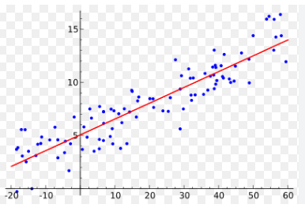
Simple linear regression

Slide 13
Requirements for simple linear regression
1.The sample of paired data is a simple random sample of quantitative data
2.The pairs of data (𝑥,𝑦) have a bivariate normal distribution, meaning the following:
  Visual examination of the scatter plot(s) confirms that the sample points follow an approximately straight line(s)
  Because results can be strongly affected by the presence of outliers, any outliers should be removed if they are known to be errors (Note: Use caution when removing data points)

Slide 14
Simple linear regression
Outlier – in a scatter plot, an outlier is a point lying far away from the other data points
Influential point – a point that strongly affects the graph of the regression line

Slide 15
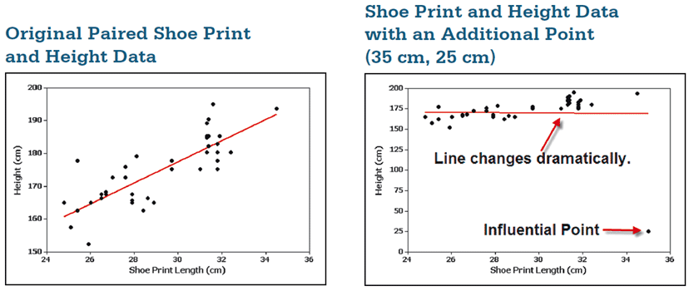
Simple linear regression

Slide 16
Simple linear regression
The additional point is an influential point because the graph of the regression line because the graph of the regression line did change considerably.
The additional point is also an outlier because it is far from the other points.

Slide 17
Residual and the least squares property
Residual – for a pair of sample 𝑥 and 𝑦 values, the difference between the observed sample value of 𝑦 (a true value observed) and the y-value that is predicted by using the regression equation 𝑦^ is the residual
  𝑅𝑒𝑠𝑖𝑑𝑢𝑎𝑙 = 𝑂𝑏𝑠𝑒𝑟𝑣𝑒𝑑 − 𝑃𝑟𝑒𝑑𝑖𝑐𝑡𝑒𝑑 = 𝑦 − 𝑦^
  A residual represents a type of inherent prediction error
  The regression equation does not, typically, pass through all the observed data values that we have
The Least Squares Property – a straight line satisfies this property if the sum of the squares of the residuals is the smallest sum possible

Slide 18
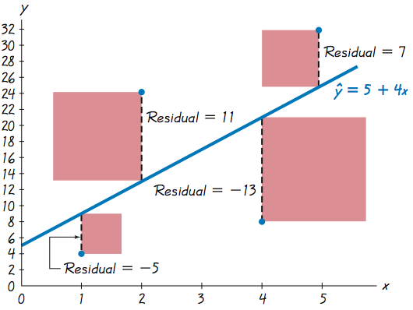
residuals

Slide 19
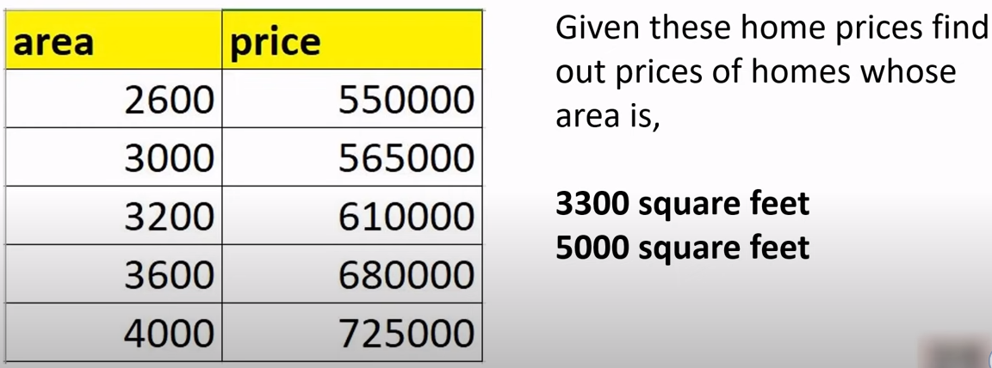
Example – Home price prediction

Slide 20
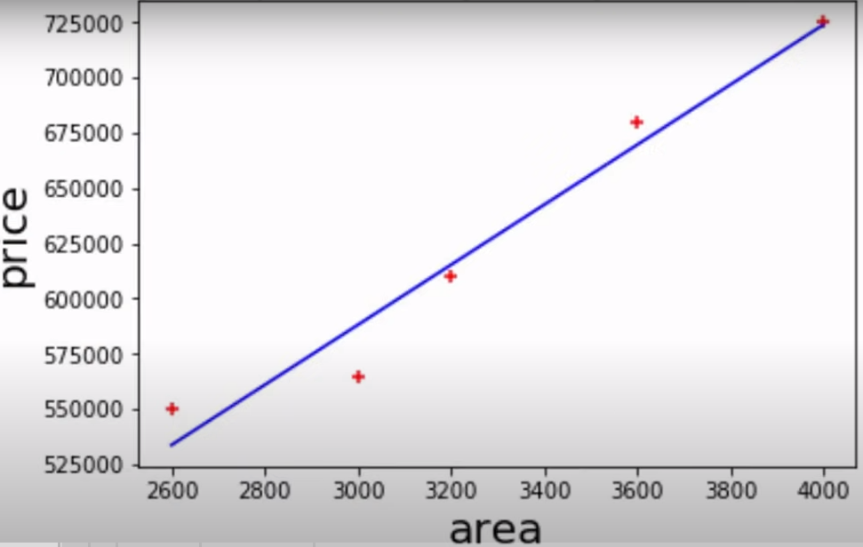
Example – Home price prediction

Slide 21
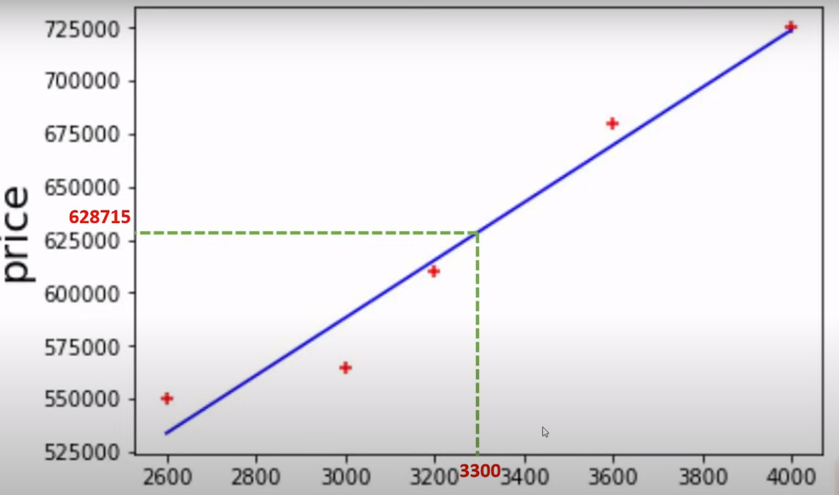
Example – Home price prediction

Slide 22
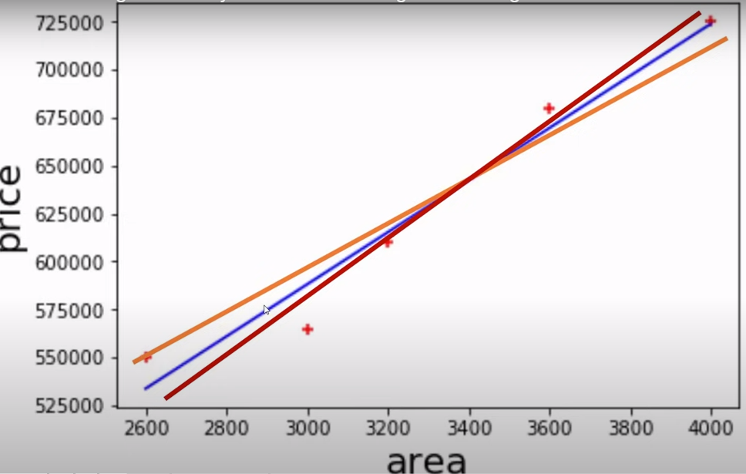
Example – Home price prediction

Slide 23
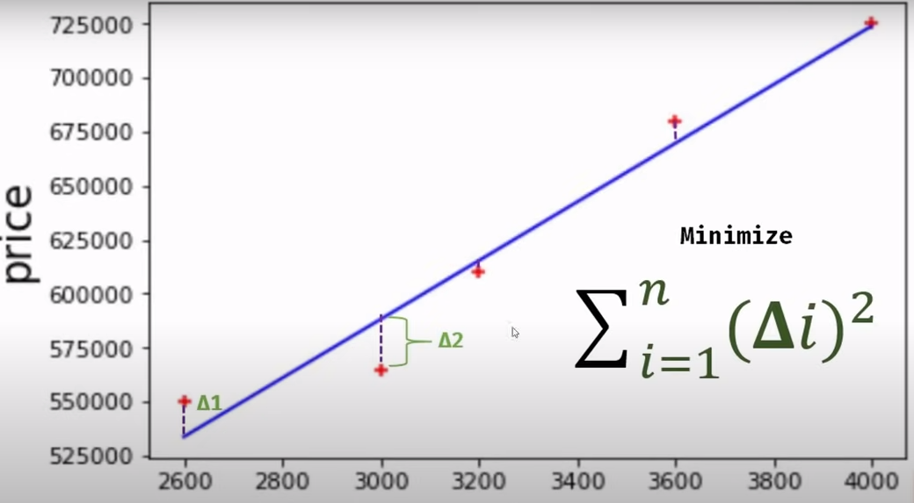
Example – Home price prediction

Slide 24
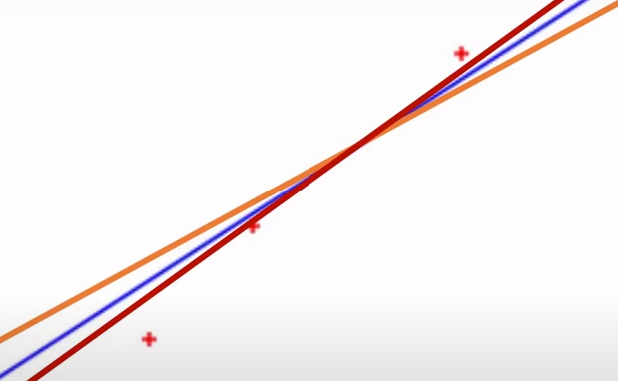
Example – Home price prediction
Find sum of squared errors for all the possible lines.
Blue line gives the minimum error.

Slide 25
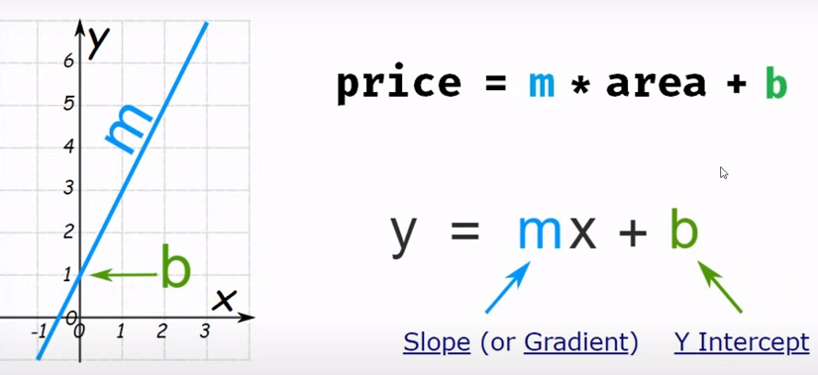
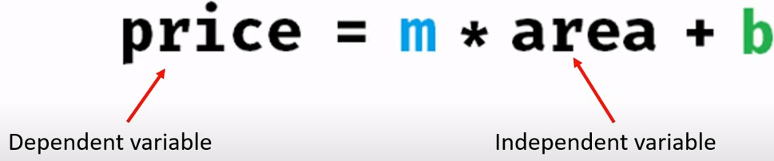
Example – Home price prediction

Slide 26
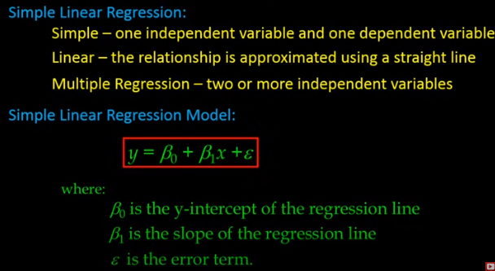
Simple linear regression

Slide 27
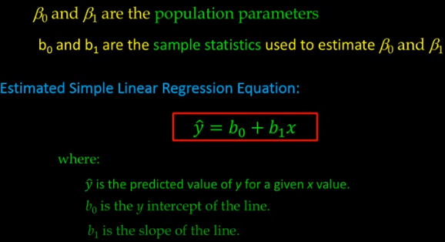
Simple linear regression

Slide 28
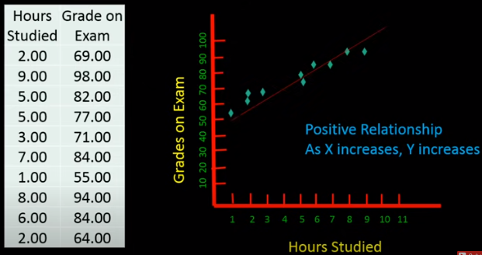
Example – Exam Grades

Slide 29
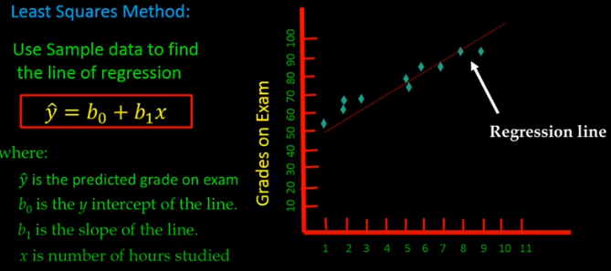
Least Squares method

Slide 30
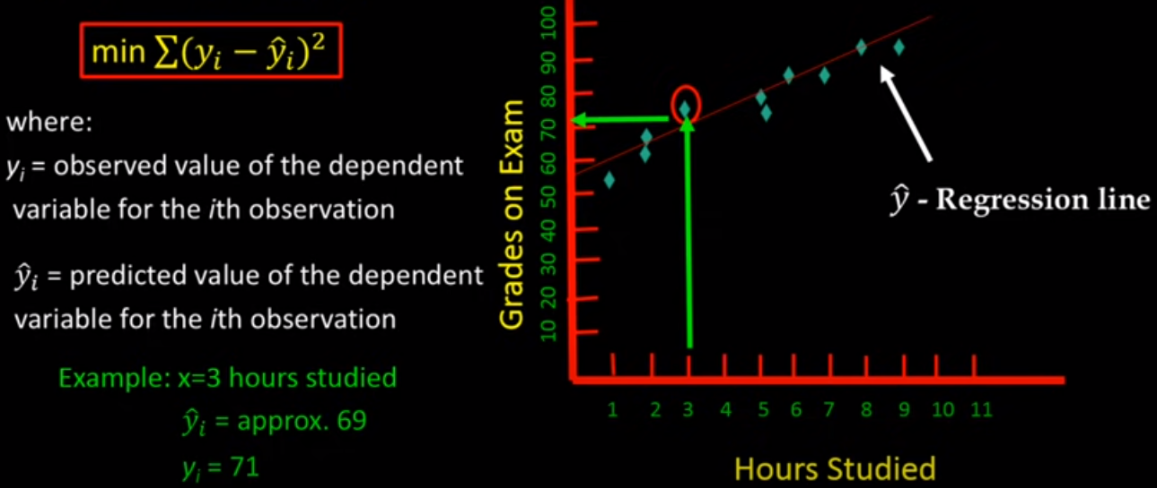
Least Squares method

Slide 31
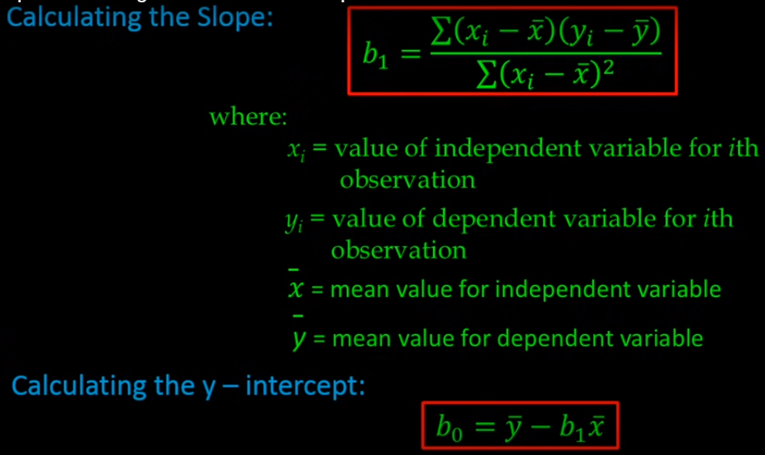
Least Squares method

Slide 32
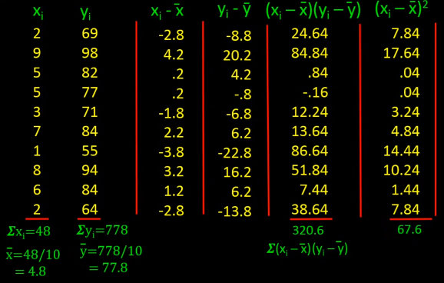
Least Squares method

Slide 33
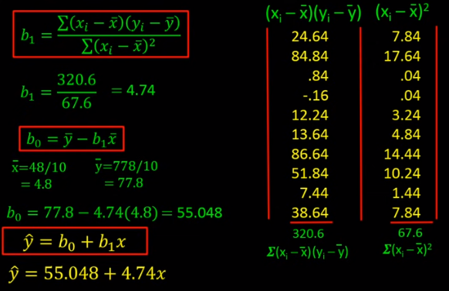
Least Squares method

Slide 34
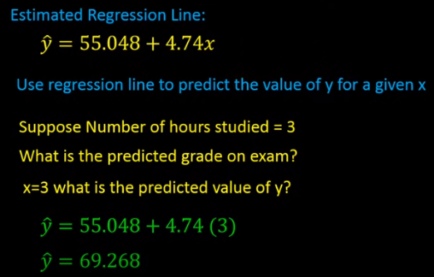
Least Squares method

Slide 35
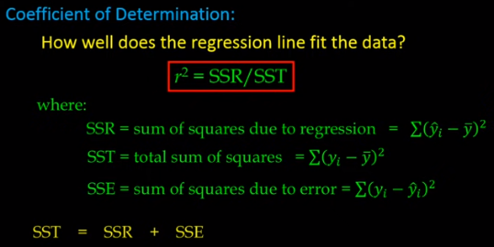
How good is the prediction?
The depends how good the regression line fits the data
The measurement the tells how good the regression line fits the data is Coefficient of Determination.

Slide 36
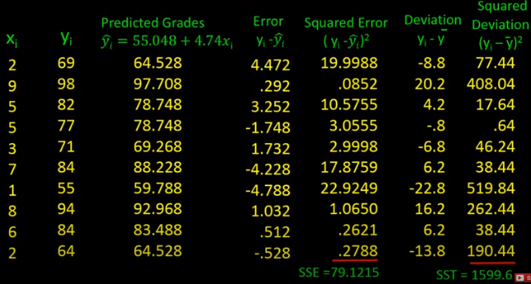
Coefficient of Determination

Slide 37
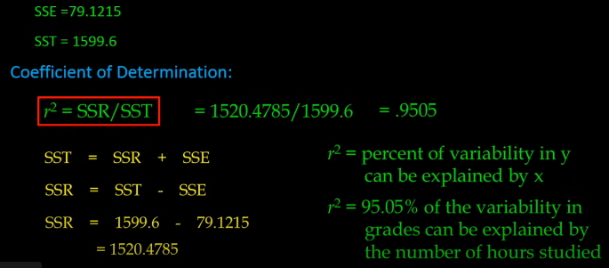
R square

Slide 38
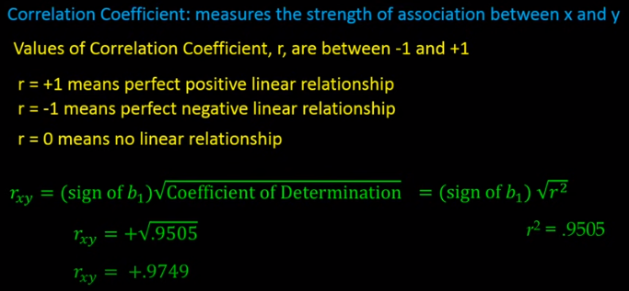
Correlation coefficient

Slide 39
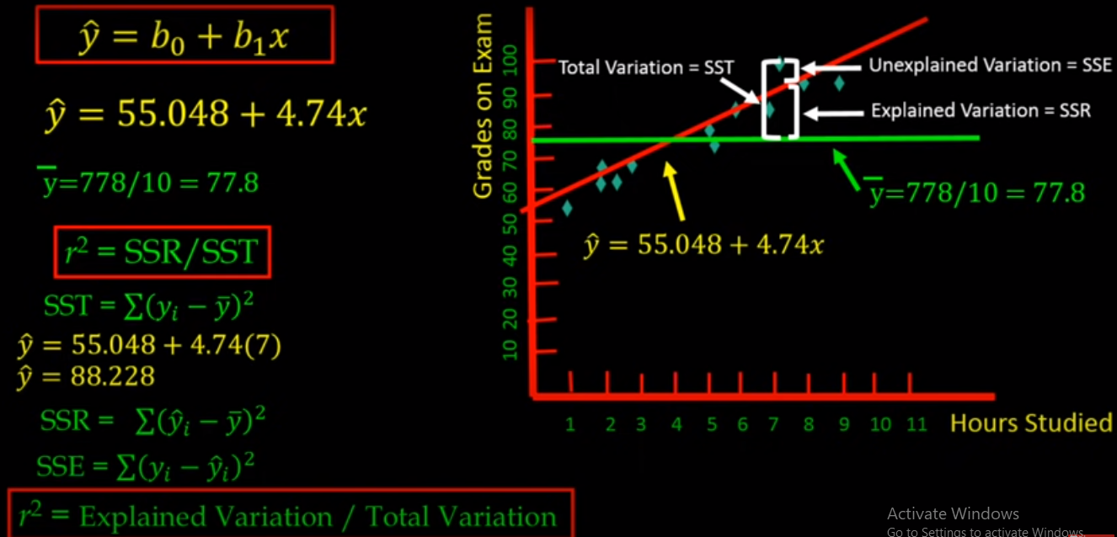
Correlation coefficient

Slide 40

Pearson’s correlation coefficient

Slide 41
Multiple Linear Regression

Slide 42
Multiple Linear Regression
Multiple linear regression (MLR), also known simply as multiple regression, is a statistical technique that uses several explanatory variables to predict the outcome of a response variable.
The goal of multiple linear regression is to model the linear relationship between the explanatory (independent) variables and response (dependent) variables.

Slide 43
Multiple Linear Regression
What Multiple Linear Regression Can Tell You
Simple linear regression is a function that allows an analyst or statistician to make predictions about one variable based on the information that is known about another variable.
Linear regression can only be used when one has two continuous variables—an independent variable and a dependent variable.
The independent variable is the parameter that is used to calculate the dependent variable or outcome.
A multiple regression model extends to several explanatory variables.

Slide 44
Multiple Linear Regression
The multiple regression model is based on the following assumptions:
There is a linear relationship between the dependent variables and the independent variables
The independent variables are not too highly correlated with each other

Slide 45
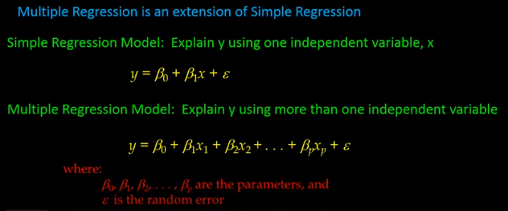
Multiple Linear Regression

Slide 46
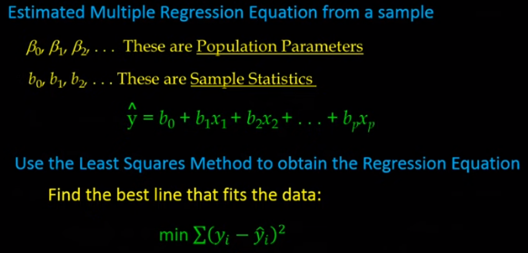
Multiple Linear Regression

Slide 47
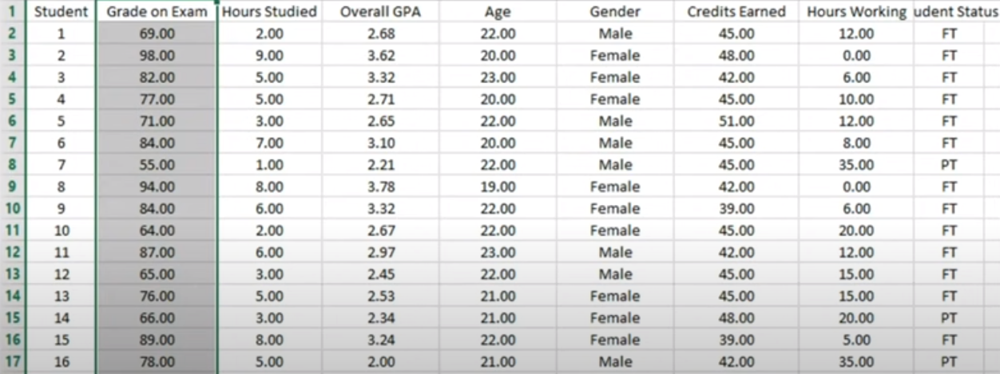
Example
Dataset

Slide 48
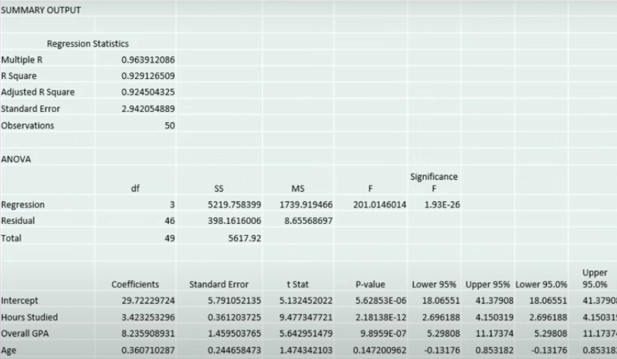
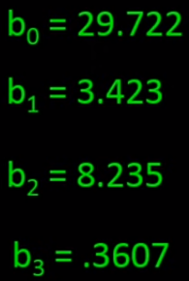
Output from excel

Slide 49
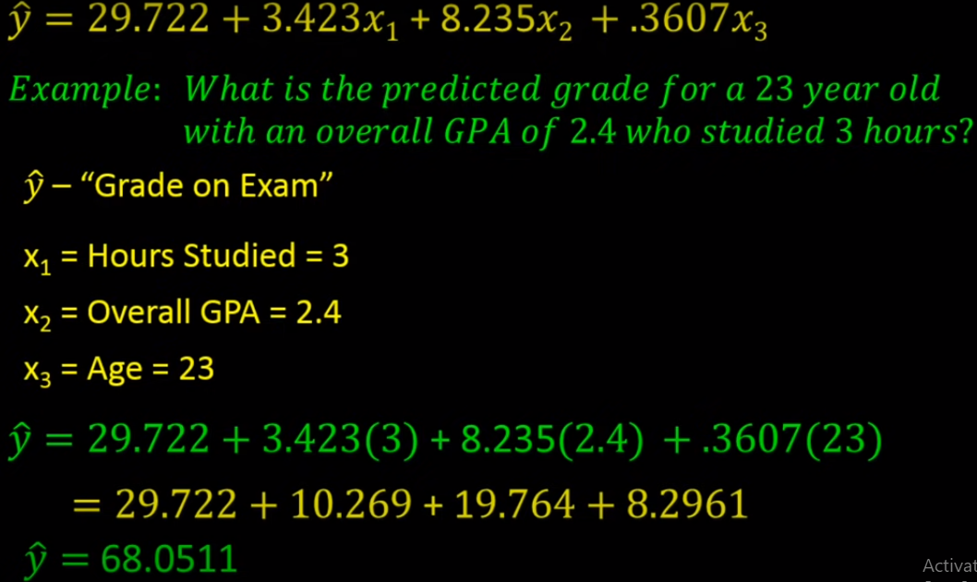
Multiple Linear Regression

Slide 50
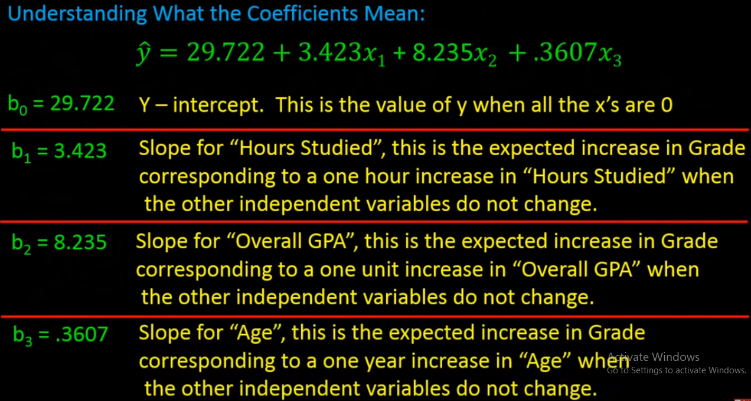
Multiple Linear Regression

Slide 51
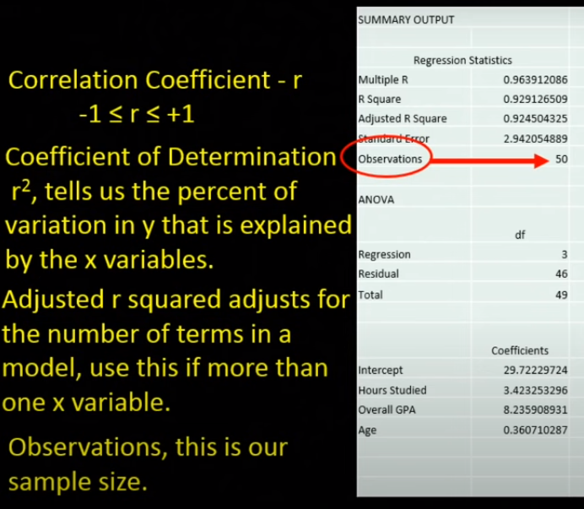
Multiple Linear Regression

Slide 52
Logistic Regression

Slide 53
AIMS
When and Why do we Use Logistic Regression?
Binary
Multinomial
Theory Behind Logistic Regression
Assessing the Model
Assessing predictors
Things that can go Wrong
Interpreting Logistic Regression

Slide 54
When and why
To predict an outcome variable that is categorical from one or more categorical or continuous predictor variables.
Used because having a categorical outcome variable violates the assumption of linearity in normal regression.

Slide 55
When and why
No assumptions about the distributions of the predictor variables.
Predictors do not have to be normally distributed
Logistic regression does not make any assumptions of normality, linearity, and homogeneity of variance for the independent variables.
Because it does not impose these requirements, it is preferred to discriminant analysis when the data does not satisfy these assumptions.

Slide 56
Logistic Regression
Logistic regression is used to analyze relationships between a dichotomous dependent variable and continue or dichotomous independent variables.
A dichotomous variable is one that takes on one of only two possible values when observed or measured. ... For example, a dichotomous variable may be used to indicate whether a piece of legislation passed. The dichotomous variable (pass/fail) is a representation of the actual, and observable, vote on the legislation.
Logistic regression combines the independent variables to estimate the probability that a particular event will occur, i.e. a subject will be a member of one of the groups defined by the dichotomous dependent variable.

Slide 57
Logistic Regression
Logistic regression is a type of binary classification machine learning algorithm used to predict the probability of something happening, in our case whether or not an event will occur.
The name “logistic regression” is derived from the concept of the logistic function that it uses. The logistic function is also known as the sigmoid function. The value of this logistic function lies between zero and one.

Slide 58
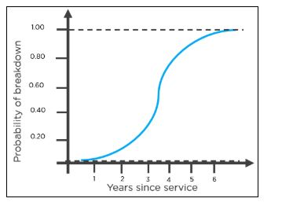
The following is an example of a logistic function we can use to find the probability of a vehicle breaking down, depending on how many years it has been since it was serviced last.

Slide 59
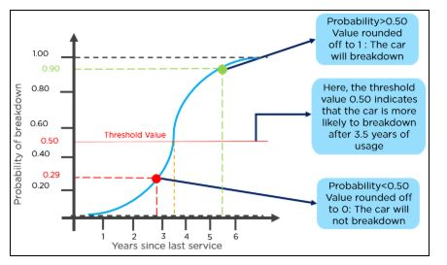

Slide 60
Logistic Regression
Logistic regression aims to solve classification problems. It does this by predicting categorical outcomes, unlike linear regression that predicts a continuous outcome.
In the simplest case there are two outcomes, which is called binomial, an example of which is predicting if a tumor is malignant or benign. Other cases have more than two outcomes to classify, in this case it is called multinomial. A common example for multinomial logistic regression would be predicting the class of an iris flower between 3 different species.

Slide 61
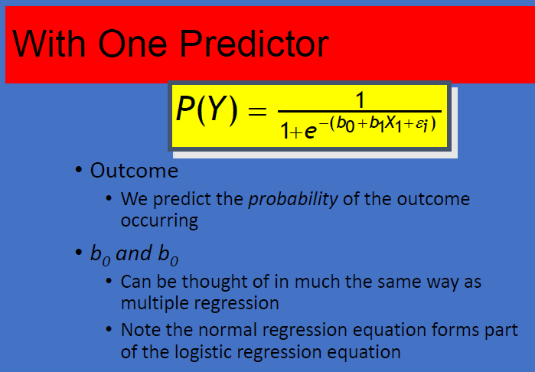

Slide 62
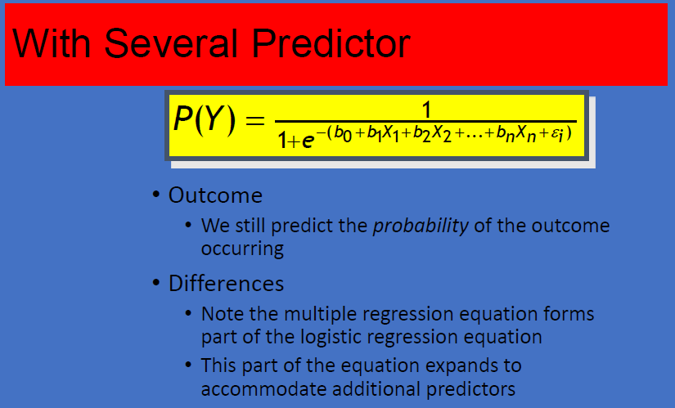

Slide 63
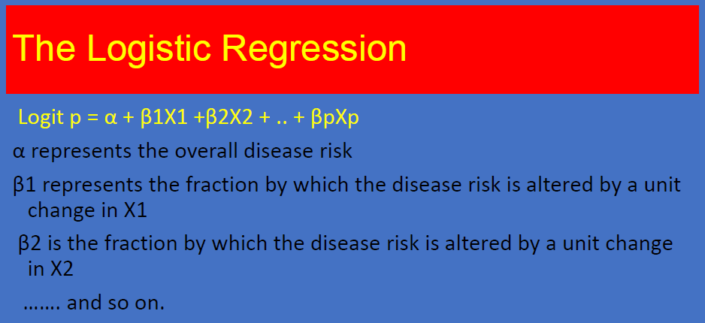

Slide 64
Objectives Of logistic regression
Identify the independent variable that impact in the dependent variable
Establishing classification system based on the logistic model for determining the group membership

Slide 65
Types of logistic regression
BINARY LOGISTIC REGRESSION
  It is used when the dependent variable is dichotomous.
MULTINOMIAL LOGISTIC REGRESSION
  It is used when the dependent or outcomes variable has more than two categories.

Slide 66
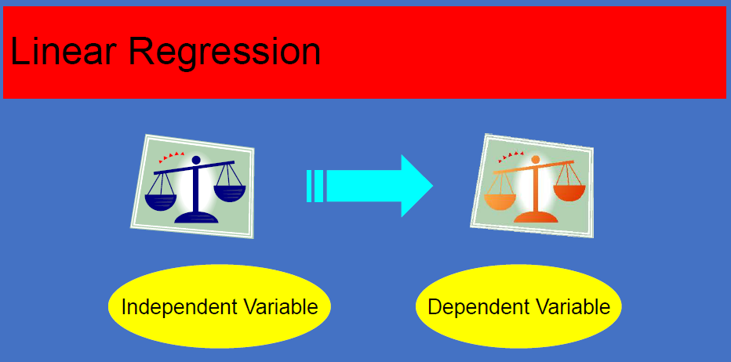

Slide 67
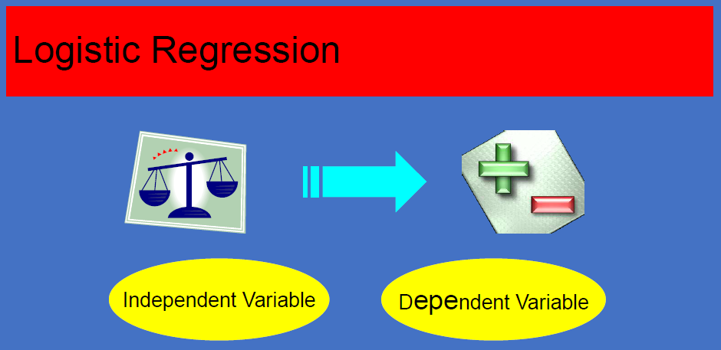

Slide 68
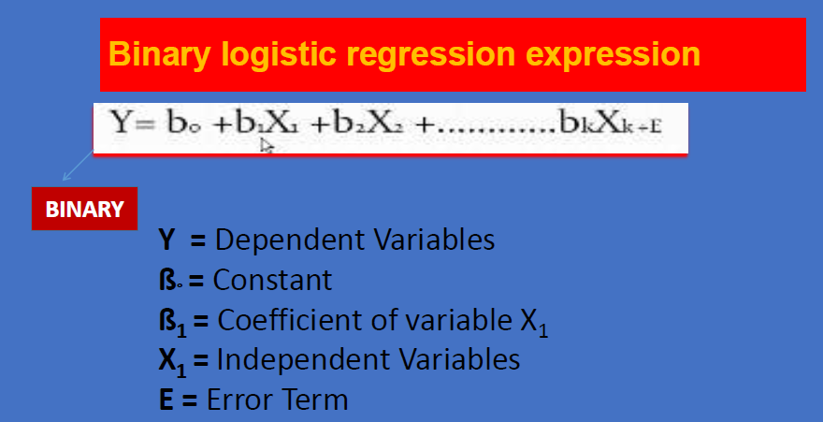

Slide 69
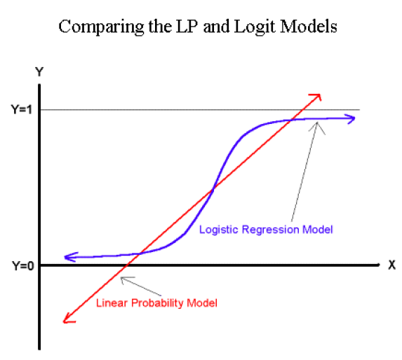

Slide 70
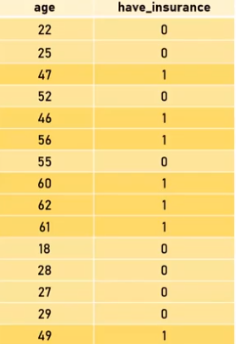
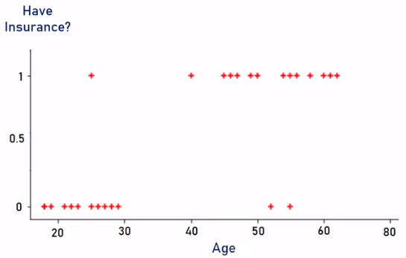
Logistic regression – Binary classification

Slide 71
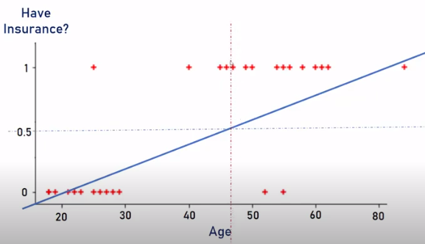
Logistic regression – Binary classification
With linear regression

Slide 72

Logistic regression – Binary classification
With logistic regression

Slide 73

Logistic regression – Binary classification

Slide 74

Logistic regression – Binary classification

Slide 75
Non-linear Regression

Slide 76
Non-linear Regression
In simple linear regression algorithm only works when the relationship between the data is linear
But suppose if we have non-linear data then Linear regression will not capable to draw a best-fit line and It fails in such conditions.
Hence, we introduce polynomial regression to overcome this problem, which helps identify the curvilinear relationship between independent and dependent variables.

Slide 77
Non-linear Regression
How Polynomial Regression Overcomes the problem of Non-Linear data?
Polynomial regression is a form of Linear regression where only due to the Non-linear relationship between dependent and independent variables we add some polynomial terms to linear regression to convert it into Polynomial regression.
Suppose we have X as Independent data and Y as dependent data. Before feeding data to a mode in preprocessing stage we convert the input variables into polynomial terms using some degree.

Slide 78

Non-linear Regression

Slide 79

Non-linear Regression

Slide 80

Non-linear Regression

Slide 81


Basis Function Regression
Polynomial basis functions
Gaussian basis functions

